Slide 1

Current status of E-HIV
4000 patients entered
220 patients deceased
145 patients diagnosed with TBC
98 patients diagnosed with AIDS
15,15 % of patient data has gone through quality control

Slide 2
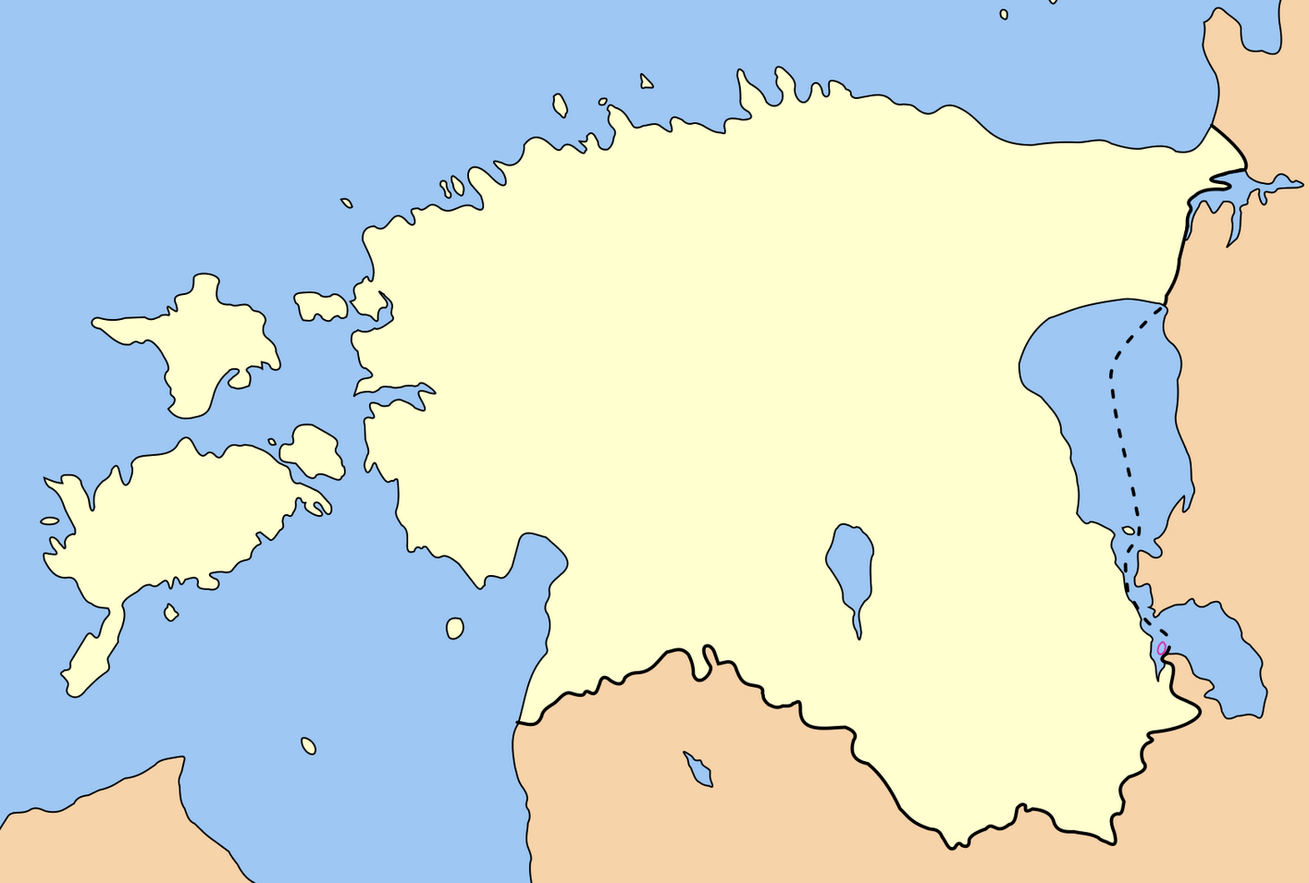
Data entering esbtablishments
(hospitals and prisons)
Viru
prison
Murru
prison
West Tallinn Central Hospital
Narva prison
Tallinna
Prison
Ida-Viru
Central Hospital
Tartu University Hospital
Tartu prison

Slide 3

Newly diagnosed HIV cases vs cases entered in E-HIV
Source: Healthboard
Notes:
Sisestatud- number of cases entered in E-HIV
Diagnoositud – diagnosed

Slide 4

Percentage of patients entered into E-HIV from total HIV diagnosed patients
Notes:
Sisestamata- missing data
Sisestatud – entered data

Slide 5
Notes:
Number of patients registered with a doctor of infectious diseases (excluding patients known to be deceased)
Patients who have seen a doctor of infectious diseases in 2012-2014 (including prisons).
Number of patients who have visited a doctor in 2014 (including prisons)
Number of patients entered into E-HIV database from 2009-2014 (including patients known to be deceased)
Patsientide arv – number of patients. Source: Health establishments

Slide 6

Proportion of patients in medical facilities

Slide 7
Patients whose data has not been entered into E-HIV since 09.10.2013

Slide 8
Distribution of gender
Notes:
Men
Women

Slide 9
Average age in database in 2014
Notes:
Men
Women
Vanus – age
Patsientide arv – number of patients

Slide 10
Age at diagnosis

Slide 11
Baseline CD4 cell count
Notes:
CD4 arv esimesel visiidil - Baseline CD4 cell count
Mediaan- median
CD4 arvu mediaan esimesel visiidil – median baseline CD4 cell count

Slide 12

Transmission routes based on gender
Notes:
Määramata- unknown
Muu – Other
IDU – PWID
MSM
Hetero sexual

Slide 13
ART in E-HIV

Slide 14



Collaborations
Estonian Research Funding
Ministry of Social Affairs
Estonian Research Council
National Institute for Health Development
SA Archimedes

Slide 15
Collaborations
Microbiology Institute, University of Tartu
Department of Public Health, University of Tartu
GlaxoSmithKline
Gilead
EuroCoord
Professor Sunil K. Ahuja, M.D. University of Texas, San Antonio Department of Health Science

